Slide 1
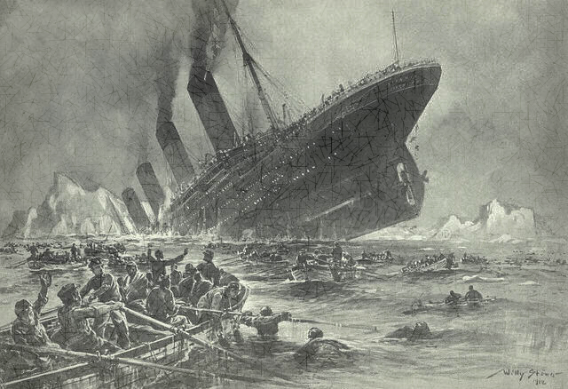
Who would survive the Titanic disaster ?
Trying the Kaggle “Titanic” machine learning challenge
Made by: Omer Sharon & Peter Yagodin University Of Haifa Faculty of Social Studies Dept. Information systems

Slide 2
Feature cleaning and engineering
In order to be able to work efficiently with our data, we cleaned our dataset of missing and irrelevant data (like PassengerId).
For the “Age” and “Fare” features, we replaced the missing values with the average of the column.
For the “Embarked” feature, we replaced the missing values with the values most common in the column.
From the “Name” column we extracted an additional feature, named “Title” – which replaced it.
From “Parch” and “SibSp”, we calculated the additional feature “FamilySize” – which replaced them.
From the “Ticket” column, we extracted an additional feature “TicketType” – which replaced it.
From “Cabin” column, we extracted an additional feature “CabinType” – which replaced it.
We encoded the “Sex”, “Embarked”, “CabinType” and “Title” columns into numeric values.

Slide 3
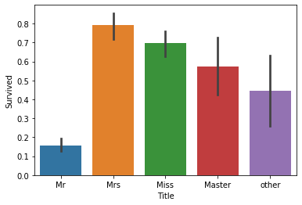
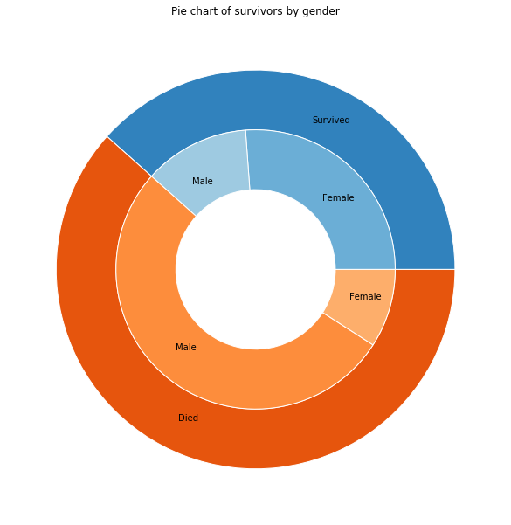
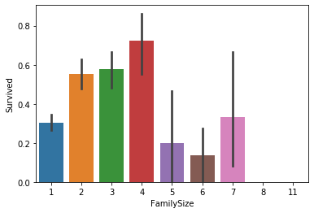
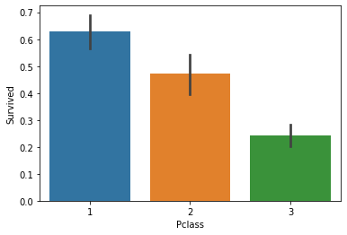
Some representational information
As the data shows us, a passenger’s survival chances were higher if they were:
Female, especially married
Of upper class
Traveled as a family of 4 people

Slide 4
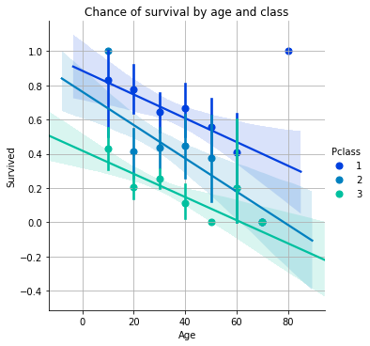
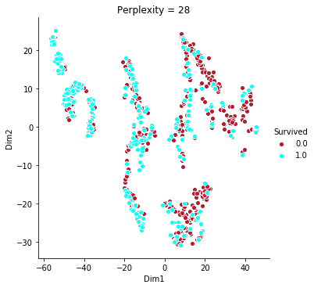
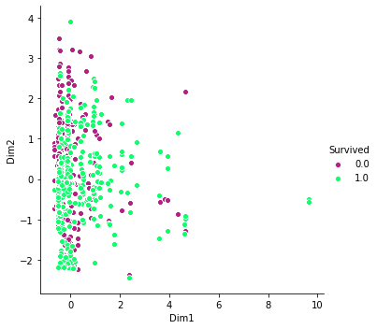
Additional observations
A passenger’s chances of survival were higher if they were young, upper-class passengers.
The t-SNE graph shows us that the data could be some-what clustered into mostly pure clusters.
The PCA clustering didn’t supply us with any meaningful insight.
t-SNE
PCA

Slide 5
PCA & Logistic regression
After splitting the train dataset into new train & validation sets, we predicted who would survive.
With a form of grid search (a for-loop that checked for the best score), we adjusted the hyper-parameter of the model (n_components).
We fitted the adjusted model to Sk-learn’s Logistic-Regression model, and then predicted the score for each iteration.
The results, using the validation set were:
Best PCA n_components: 5
PCA with linear regression score: 0.7574626865671642

Slide 6
Classification of survivors with Decision tree & Random Forest
Fitting our train & validation sets through these models, and performing a grid-search on their hyper-parameters:
min_samples_split, max_depth, max_features (and n_estimators for Random Forest)
produced the following results:
As expected, random forest’s score was higher than the decision tree’s.
Random Forest:
{'max_depth': 9, 'max_features': 5, 'min_samples_split': 5, 'n_estimators': 14}
Random Forest Classifier score: 0.835820895522388
Decision Tree:
{'max_depth': 6, 'max_features': 6, 'min_samples_split': 2}
Decision Tree Classifier score: 0.8097014925373134

Slide 7
Classification of survivors with KNN & SVM & XGBoost
Fitting our train & validation sets through a KNN, SVM and XGBoost classifier, and performing a grid-search on their hyper-parameters:
KNN:
Hyper-parameters: {'algorithm': 'ball_tree', 'leaf_size': 1, 'n_neighbors': 28, 'p': 1, 'weights': 'distance'}
KNN score: 0.7910447761194029
SVM:
Hyper-parameters: {'C': 1000000000000.0, 'gamma': 1e-05, 'kernel': 'rbf'}
SVM Classification score: 0.7835820895522388
XGBoost:
Hyper-parameters: {'learning_rate': 0.09500000000000001, 'max_depth': 6, 'n_estimators': 55, 'random_state': 0}
XGBoost Classification score: 0.8507462686567164

Slide 8
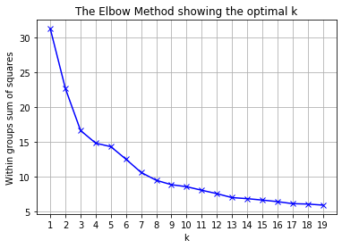
Using K-means to improve accuracy
We attempted to improve upon our PCA model by adding an additional feature we named “Cluster”.
Using the “Elbow method” graph, we deduced that the appropriate value for “n_clusters” was 3. The K-means model enabled us to classify each passenger into one of the 3 clusters.
The classification was used as said “Cluster” feature, and fed again through PCA.
The results are as follows:
Best PCA n_components: 9
PCA with linear regression score (After adding the `Cluster` feature): 0.8097014925373134
As expected, the feature improved upon our previous score.

Slide 9
Classification of survivors with a Neural Network
In order to find the right network architecture, we used a sort of Grid-Search to find: - Number of neurons for the 1st & 2nd hidden-layers (includes the possibility that there is no 2nd hidden-layer) - Learning rate - Momentum
We had a total of 9 neurons in the input-layer, and 1 neuron in the output layer.
The results are as follows:
Best score: 0.8395522388059702 Best h1: 5 Best h2: 5 Best_optimizer: ‘adam ‘

Slide 10
Kaggle results:
Using the entire train dataset, we fed each of our models the data. The results were exported to a new file (for each model), and submitted them to Kaggle scoring.
Our results were:
Kaggle score | Model
0.74162 | Decision Tree
0.76555 | Random Forest
0.67464 | KNN
0.75598 | SVM
0.7799 | XGBoost
0.66985 | PCA + Linear Regression
0.75598 | PCA + Linear Regression (with “Cluster” feature)
0.79904 | Neural Network

